Slide 1

Robotics 311 : How to build robots and make them move
Prof. Elliott Rouse
GSI Yves Nazon MS
Fall 2022
Photo credit: Brenda Ahearn / U-M CoE

Slide 2
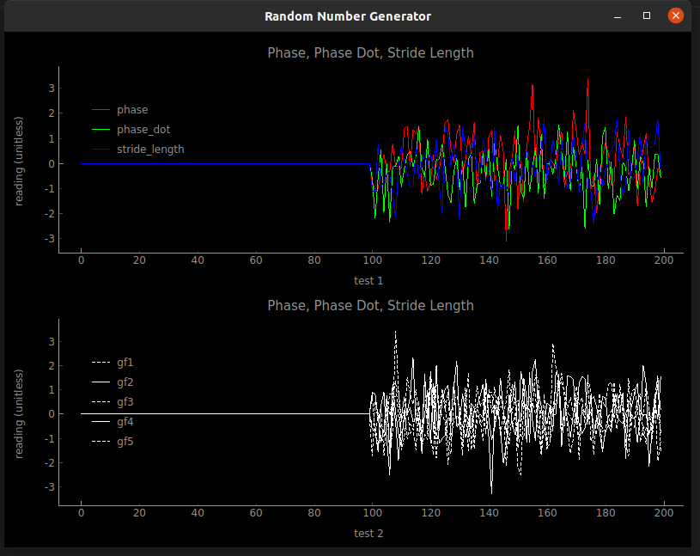


ROB 311 – Lab 12
Today, we will learn about virtual environments and real time plotting!
ROB 311

Slide 3

ROB 311 – rtplot
About rtplot
Real time plotter
Uses socket protocols for communication between devices
Socket communication is a network (wireless) form of communication
Clients send info to servers
ROB 311

Slide 4
ROB 311 – Virtual Environments
What is a virtual environment
A file structure that runs a version of python with specific dependencies and packages
Why use a virtual environment
An easy way to ensure you have the correct packages for a specific project
Avoid many issues
Contaminating native python versions
Dependency conflicts
Need for admin access
ROB 311

Slide 5
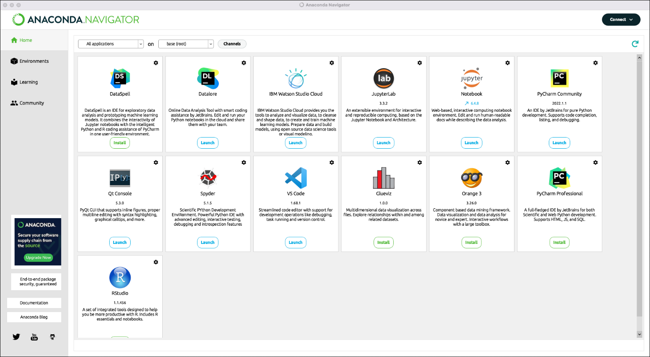
ROB 311 – Anaconda
About anaconda
Open source distribution of python (and R)
Made to assist with package management and usage for multiple projects
OS agnostic
ROB 311

Slide 6
ROB 311– Todays Lab
Create a virtual environment using anaconda
Use the real time plotter to plot ballbot states
ROB311_rtplot_demo.py has example syntax
ROB 311

Slide 7
ROB 311 – Creating Virtual Environment with Anaconda
Download Anaconda
https://www.anaconda.com/products/distribution
Follow download prompts
OS specific download assistance found here: https://docs.anaconda.com/anaconda/install/
Conda commands cheat sheet: https://docs.conda.io/projects/conda/en/4.6.0/_downloads/52a95608c49671267e40c689e0bc00ca/conda-cheatsheet.pdf
Open terminal (Mac/Linux) or use anaconda navigator → CMD prompt (windows)
ROB 311

Slide 8
ROB 311 – Creating Virtual Environment (Cont.)
Check if conda is installed on your path
Conda –V
Check if Conda is up to date
Conda update conda
Create a Virtual Environment
Ex: conda create --name sample_venv python=3.8
Make sure python version is 3.9
Activate the environment
conda activate sample_venv
Deactivate the above environment once your work is done
conda deactivate
ROB 311

Slide 9
ROB 311– Using rtplot
Clone rtplot repo from git
https://github.com/jmontp/rtplot (clone repo first!)
Follow instructions for installation and downloading dependencies
Do this within virtual environment!
Replace repo version of server.py with canvas version
Check correctness using example_code.py
ROB 311

